Slide 1
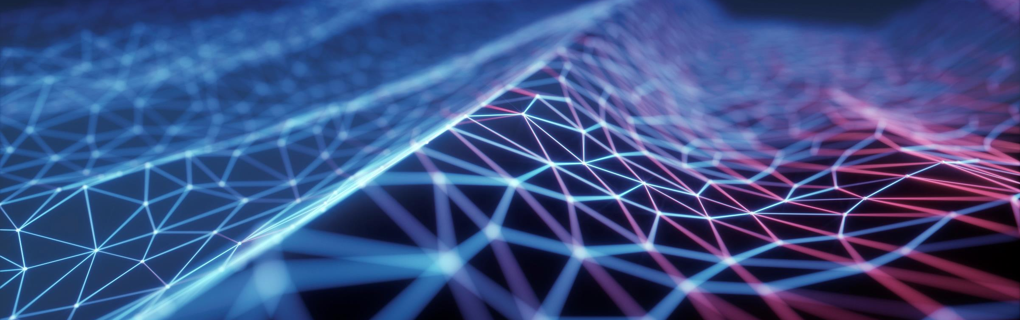
sVision
GOGGLES FOR VISUALLY IMPAIRED

Slide 2
NEED
Of the five human senses, the eyes are our most important sensory organs, helping us perceive up to 80% of the impressions and input we use to make sense of our surroundings.
Visually impaired people do not see the world as we do. Through our product, we will try to assist them in developing a better sense of their surroundings.
According to WHO report as of 8 October 2020 globally, 1 billion people have a vision impairment that could have been prevented or has yet to be addressed.
Currently no such product exists in the market which can provide the features that sVision provides.

Slide 3

SOME KEY FEATURES
It can identify obstacles and alert the user by producing vibrations.
It produces ultra sound waves to identify an obstacle, and notifies the user .
Proximity sensors for fast moving and close object alerts.

Slide 4




TECH REQUIREMENTS
Proximity sensor
Sensor band
Echolocation
Connectivity and
Syncing

Slide 5
CONTENTS OF sVision
sVision is a 3 piece-set of devices interlinked with each other.
Firstly, the main product is the spectacles/glass worn over eyes as normal people use them. The glasses come in Tinted, Semi-Tinted and Non-Tinted variety. The glasses are connected and perfectly synced with both the other wearables.
The second part of the set includes the 2 wearables on hand, both worn on each. These are connected and perfectly synced to where each of the hand bands give pulse signals based primarily on the directions they are pointed respectively and secondarily to the region they are in.

Slide 6
HOW IT WORKS:
The main working principle of our device is Echolocation.
High frequency sound waves are emitted from the device.
When these waves hit a nearby object it will produce echoes. The echo bounces off the object and returns to the goggles.
From these reflected waves the distance of the object can be approximated.
This data is then sent to the wearable band to produce pulse vibrations.
The intensity of pulse vibrations increases as you approach the obstacle.

Slide 7
DEVICE SPECIFIC FEATURES
The spectacles/glasses consists of built in sonar equipment, and connections to the hand wearables
The sonar equipment we will be using has a perfect detection range of 100m and used as a single device, it will fit in palm of the person
WHAT WE PLAN TO DO :-
Split the original sonar device into 2 parts to fit in the “temples to earpiece” part of the spectacles
Place the device to connect the set-pieces in the bridge of the glasses
To handle the increased weight of the glasses with comfort we will add rubber-foam nose pads
Links for additional external devices mentioned
Sonar equipment :- https://www.amazon.in/Docooler-Fishfinder-Transducer-Electronic-Equipment/dp/B01LY9K0X1
Rubber-foam nose pads :-https://www.amazon.in/GMS-Self-Adhesive-Count-Black/dp/B013P7SMBI
Rubber-foam nose pads alt :-https://www.amazon.in/Gejoy-Adhesive-Nosepads-Non-Slip-Eyeglass/dp/B07K811ZTZ

Slide 8
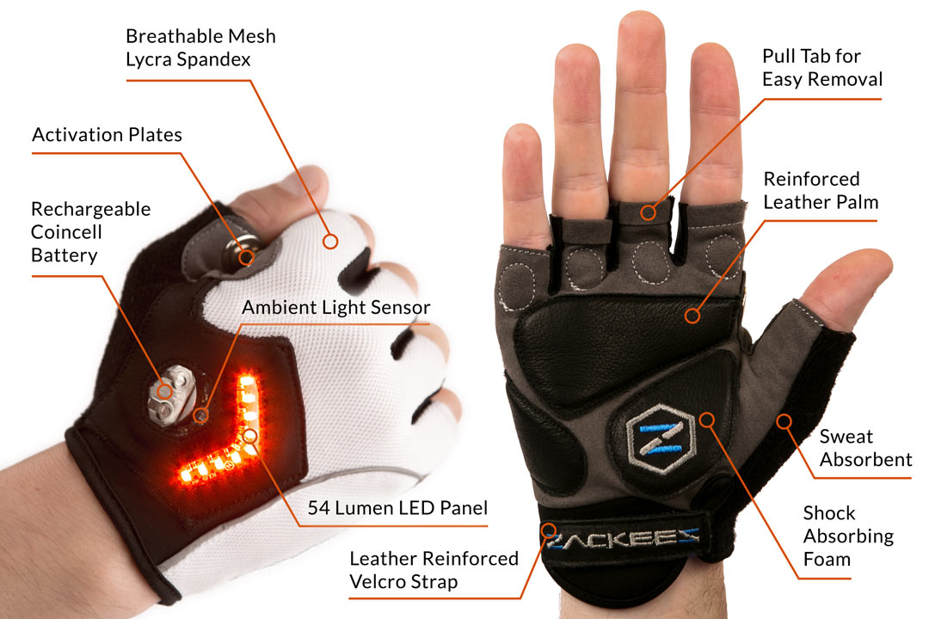
DEVICE SPECIFIC FEATURES
Links for additional external devices mentioned
Hand wearables CONCEPT MODEL
The hand wearables come in a pair, perfectly synced with each other so as to avoid misunderstandings between direction of the incoming object or danger. The hand wearables have pulse vibration emitter in the, that means that they will give pulse signals if an object comes with the range of sonar and proximity sensors
WHAT WE PLAN TO DO :-
Give separate patterns or signals to differentiate between signals from sonar and proximity sensors

Slide 9
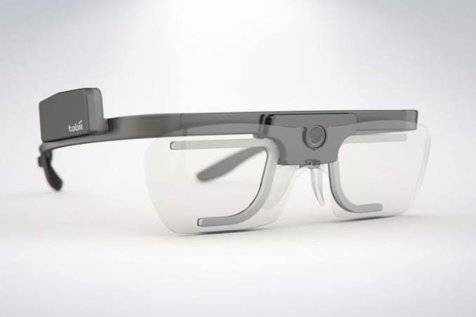
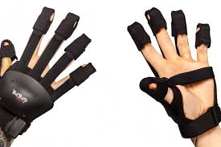
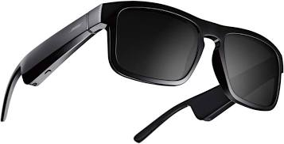
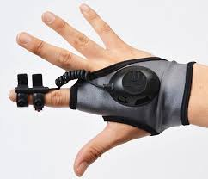
CONCEPT MODEL FOR THE PRODUCT
SPECTACLES WITH SENSORS FITTED ON EACH SIDE AND TINTED LENS
GLASSES WITH "CONNECTION TO HAND BANDS” ON THE BRIDGE OF THE SPECTACLES
HAND WEARABLES

Slide 10
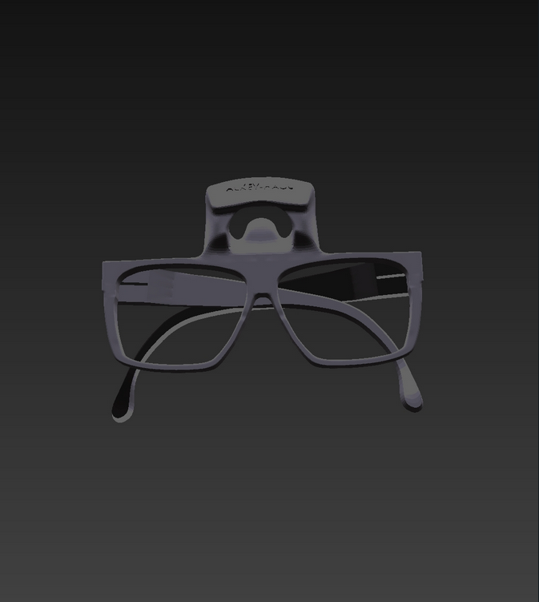
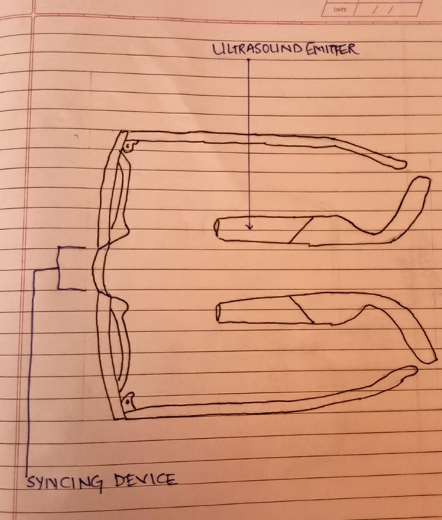
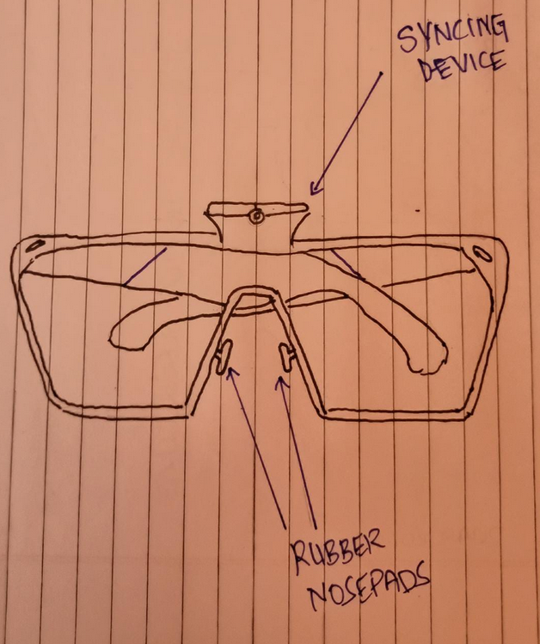
OUR DESIGN: SPECTACLES

Slide 11
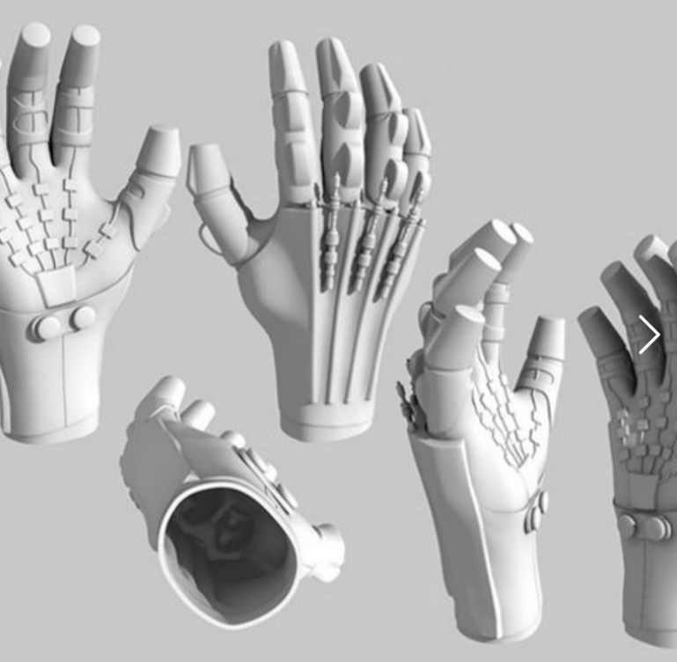
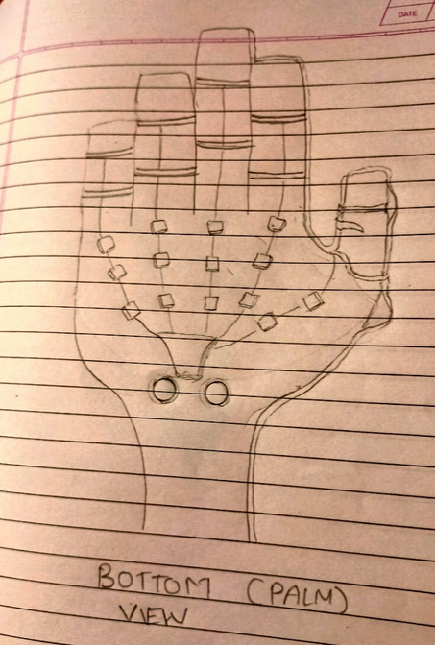
OUR DESIGN: HAND WEARABLES

Slide 12

MADE BY:
ADITYA DAHIHANDEKAR -(101048)
AADAM GANDHI - (101066)
ARNAV DESHPANDE -(101055)
ROHAN GADGIL -(101063)
SAMARTH DANI -(101049)

